Slide 1
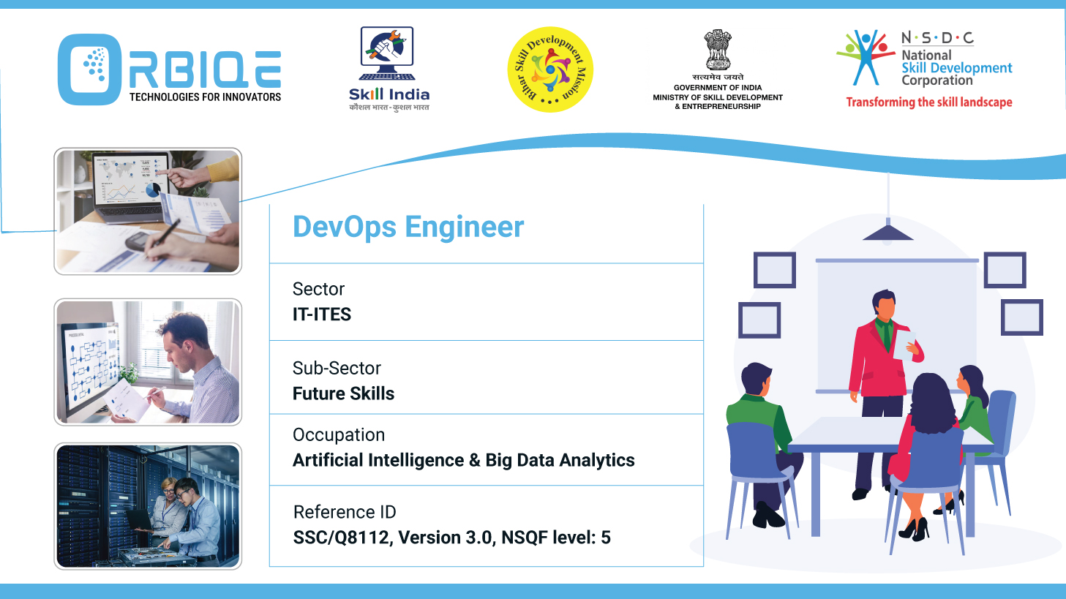
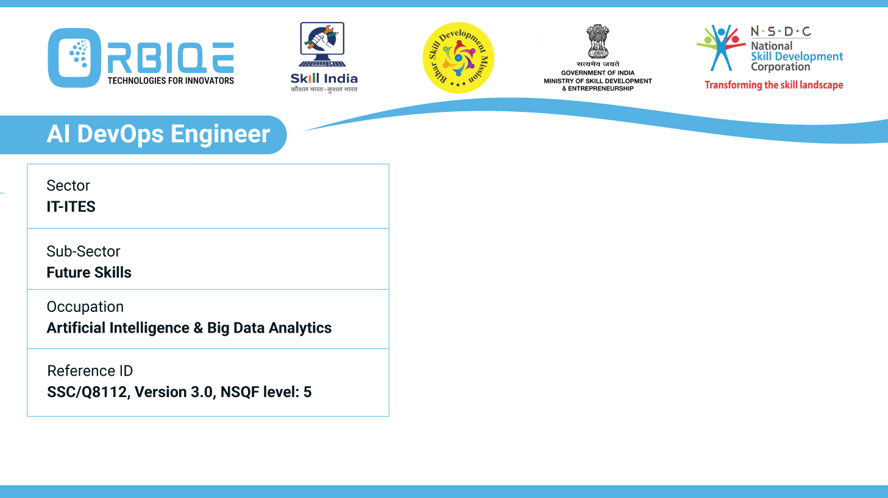
Name- Krishna Kant Dubey

Slide 2

Set up monitoring and logging

Slide 3
Agenda
Setup monitoring
Setup Logging
Detect anomalies
Prometheus
Grafana

Slide 4
Setup monitoring

Slide 5
Implement version control practices

Slide 6
Thank You

